Slide 1
SAT Registration

Slide 2
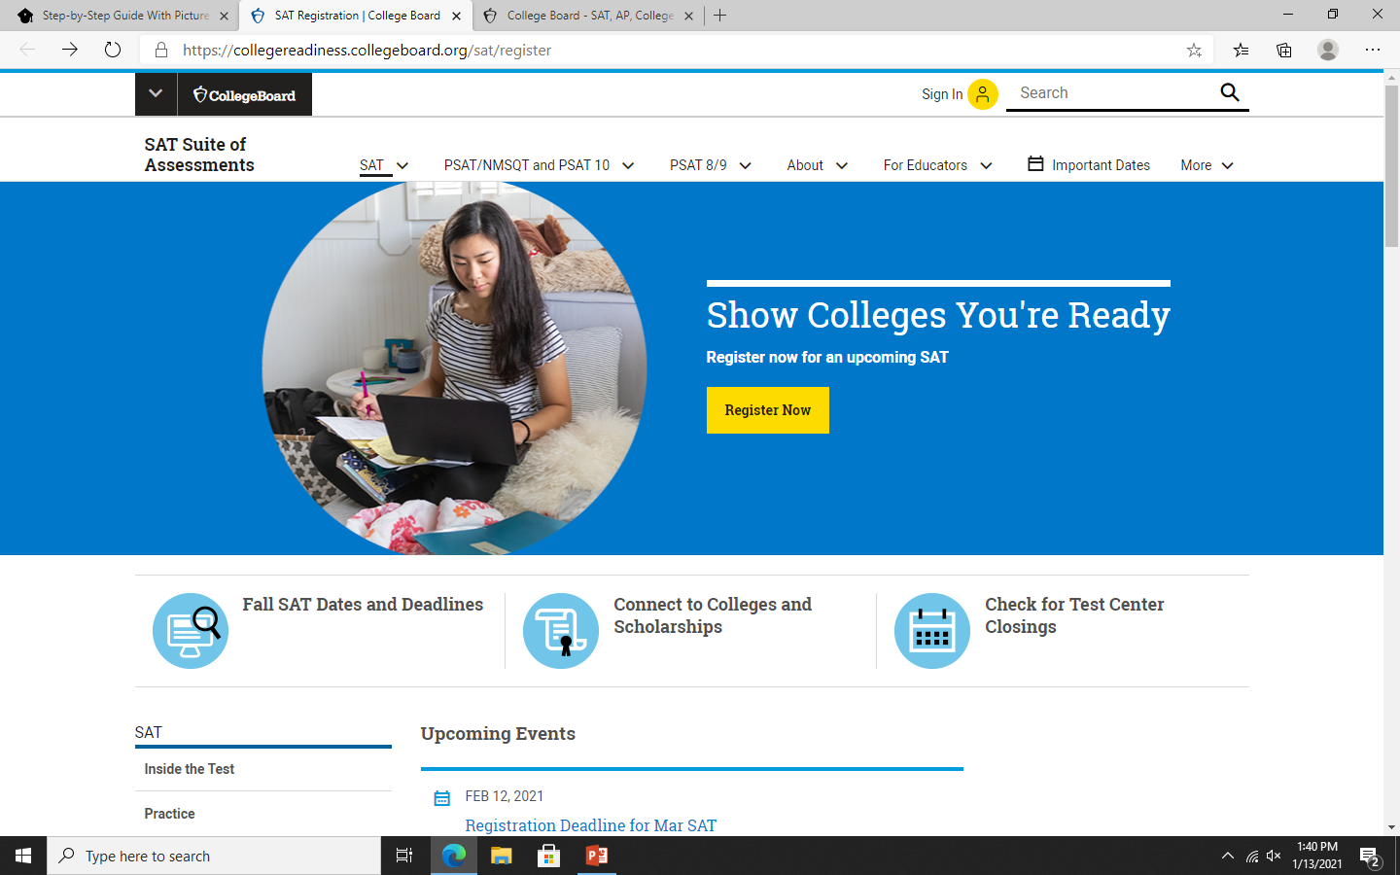
STEP 1
Go to collegeboard.org, click the link that takes you directly to the registration page
SAT Registration | College Board

Slide 3
Step 2
Then click Register Now and login or register to College Board

Slide 4
STEP 3
Click Register for the SAT

Slide 5
Step 4
You should now be on this page. According to the College Board, the registration process will take around 30-40 minutes (yikes—why should it take this long to register for the SAT? You’ll find out soon!) Click the button to continue.

Slide 6
STEP 5
Next comes the long questionnaire. Make sure to complete this completely and correctly.

Slide 7
STEP 6
Next, you’ll choose your test date and center on the Choose Your Test & Date page. If you have any testing accommodations or an SAT fee waiver, this is where you will enter that information.

Slide 8
Signing Up for the SAT: 3 Essential Tips
#1: Choose the Best Location for you
#2: Register Early
This allows you to have time to study and be well-prepared.
#3: Apply for a Fee Waiver(If You Qualify)
To be eligible, you must be a low-income 11th or 12th grader in the US (or US territories). Each fee waiver covers the following:
Two free SATs (with or without Essay)
Two free Question-and-Answer Service or Student Answer Service reports
Unlimited SAT score reports to send to schools

